Slide 1
IUMPR Tools
Partnering with Posit for Progress on Environmental Stewardship
Saumiitha Leelakrishnan
Technical Specialist – Global Emissions Center of Excellence, Cummins
Posit Conf : Aug 12 – 14 ‘24
*© 2024 Cummins Inc., All rights reserved.
Public

Slide 2

IUMPR Tools
* IUMPR – In –Use Monitoring Performance Ratio
*© 2024 Cummins Inc., All rights reserved.
Public

Slide 3


IUMPR Tools
* IUMPR – In –Use Monitoring Performance Ratio
*© 2024 Cummins Inc., All rights reserved.
Public

Slide 4
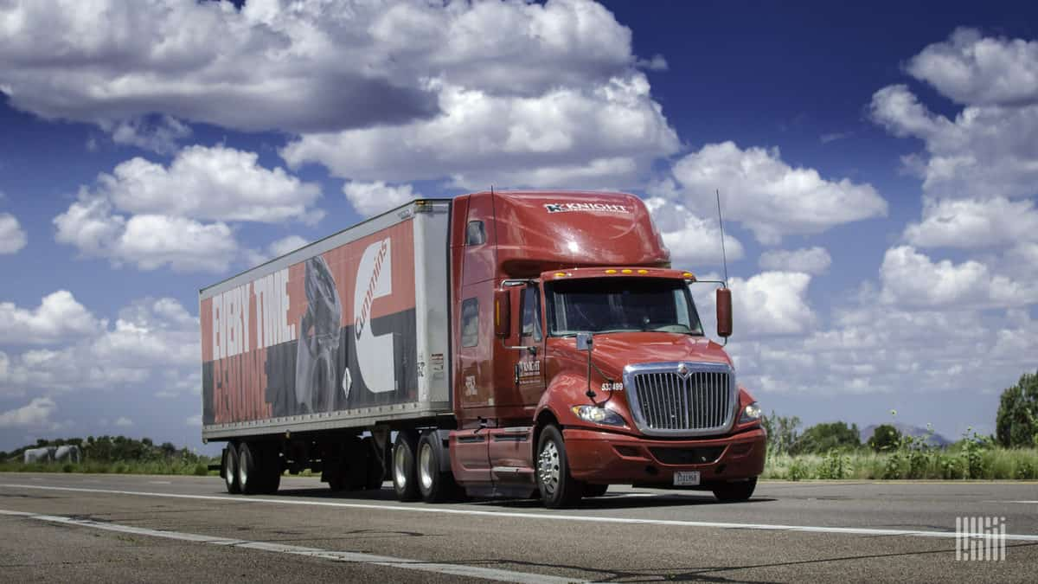


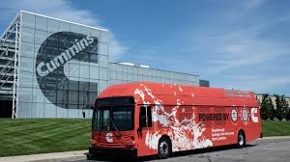
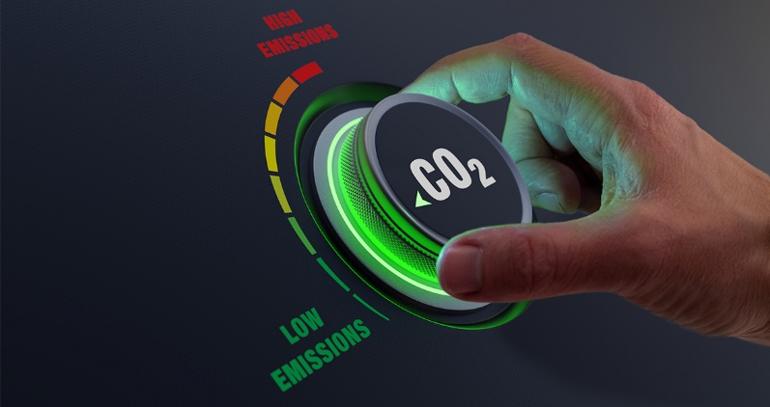

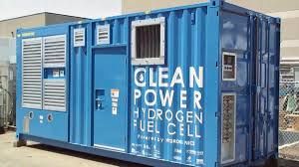
IUMPR Tools
* IUMPR – In –Use Monitoring Performance Ratio
*© 2024 Cummins Inc., All rights reserved.
Public

Slide 5

IUMPR Tools
STEP 1
GRASP YOUR NEEDS
* IUMPR – In –Use Monitoring Performance Ratio
*© 2024 Cummins Inc., All rights reserved.
Public

Slide 6


IUMPR Tools
In-Use Monitor Performance Ratio (IUMPR) data allows us to verify that diagnostics are actively making decisions
On Board Diagnostics :
Systems and Algorithms to detect failures which adversely affect Engine Emissions
* IUMPR – In –Use Monitoring Performance Ratio
*© 2024 Cummins Inc., All rights reserved.
Public

Slide 7







IUMPR Tools
Telematics & Datalogger data
* IUMPR – In –Use Monitoring Performance Ratio
*© 2024 Cummins Inc., All rights reserved.
Public

Slide 8

IUMPR Tools
WHY DID WE USE ETL (Extract, Transform,Load) ?
High volume Dataset
* IUMPR – In –Use Monitoring Performance Ratio
*© 2024 Cummins Inc., All rights reserved.
Public

Slide 9

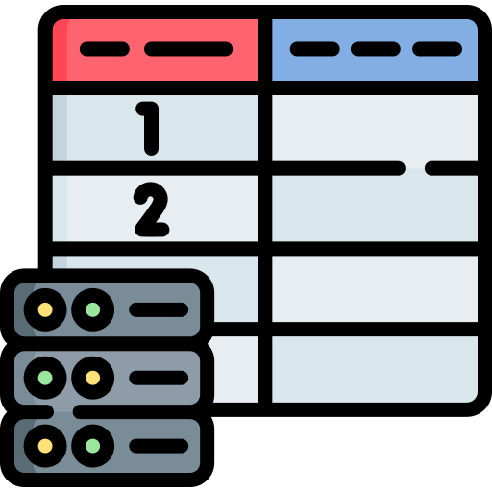


IUMPR Tools
WHY DID WE USE ETL (Extract, Transform, Load) ?
Multiple Disparate sources
* IUMPR – In –Use Monitoring Performance Ratio
*© 2024 Cummins Inc., All rights reserved.
Public

Slide 10

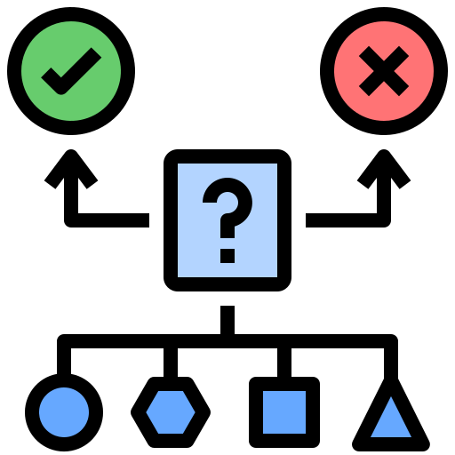
IUMPR Tools
WHY DID WE USE ETL (Extract, Transform, Load) ?
Data Cleaning & Enrichment
* IUMPR – In –Use Monitoring Performance Ratio
*© 2024 Cummins Inc., All rights reserved.
Public

Slide 11






IUMPR Tools
Read from Delta Lake
pyodbc
numpy
Pandas
SQLAlchemy
* IUMPR – In –Use Monitoring Performance Ratio
*© 2024 Cummins Inc., All rights reserved.
Public

Slide 12
IUMPR Tools
WHY DID WE BRING DATA TO SQL?
Engine Platform
Model Year
Family
Application
ESN
Relational Data
* IUMPR – In –Use Monitoring Performance Ratio
*© 2024 Cummins Inc., All rights reserved.
Public

Slide 13

IUMPR Tools
STEP 2
USE YOUR NEEDS AS A COMPASS
* IUMPR – In –Use Monitoring Performance Ratio
*© 2024 Cummins Inc., All rights reserved.
Public

Slide 14


IUMPR Tools
WHAT WERE THE NEEDS?
Predictive Modelling to identify Duty Cycle & Application
Interactively Explore & Communicate
* IUMPR – In –Use Monitoring Performance Ratio
*© 2024 Cummins Inc., All rights reserved.
Public

Slide 15




IUMPR Tools
Choice of R Shiny Web Application
Highlight Applications
Population Distribution
Interactive visualization
Workable Export
* IUMPR – In –Use Monitoring Performance Ratio
*© 2024 Cummins Inc., All rights reserved.
Public

Slide 16






IUMPR Tools
HOW DID WE BOOST?
Delve Deeper!
Making your analyses not just informative but truly immersive
* IUMPR – In –Use Monitoring Performance Ratio
*© 2024 Cummins Inc., All rights reserved.
Public

Slide 17

IUMPR Tools
STEP 3
ADVANCE AND ADAPT
* IUMPR – In –Use Monitoring Performance Ratio
*© 2024 Cummins Inc., All rights reserved.
Public

Slide 18

IUMPR Tools
sklearn.cluster
Simplest and popular unsupervised Machine Learning Algorithm
K – means Clustering
Python Library: scikit-learn
Sklearn.cluster
Sklearn.neighbors
* IUMPR – In –Use Monitoring Performance Ratio
*© 2024 Cummins Inc., All rights reserved.
Public

Slide 19

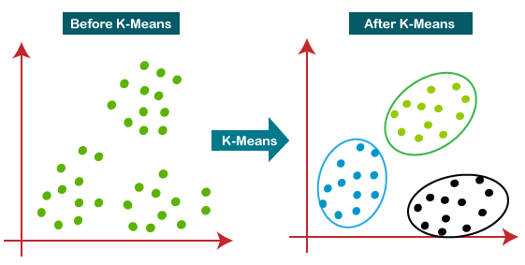
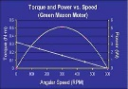




IUMPR Tools
Engine Features
Duty Cycle
Categorization
* IUMPR – In –Use Monitoring Performance Ratio
*© 2024 Cummins Inc., All rights reserved.
Public

Slide 20


IUMPR Tools
STEP 4
GENERATE & ANALYZE REPORTS
* IUMPR – In –Use Monitoring Performance Ratio
*© 2024 Cummins Inc., All rights reserved.
Public

Slide 21





IUMPR Tools
Generate Reports
Proactive Reporting & communication to Product Engineering
* IUMPR – In –Use Monitoring Performance Ratio
*© 2024 Cummins Inc., All rights reserved.
Public

Slide 22




IUMPR Tools
WHY DID WE USE QUARTO?
Weave Code , text and Graphs
Batch processing
Enables Automated Report Generation
Git Version Control
* IUMPR – In –Use Monitoring Performance Ratio
*© 2024 Cummins Inc., All rights reserved.
Public

Slide 23

IUMPR Tools
STEP 5
MONITOR AND MAINTAIN
* IUMPR – In –Use Monitoring Performance Ratio
Public

Slide 24



IUMPR Tools
Monthly / Quarterly Data Refresh and Report Generation
Action Warranted, Reason, Direction
Reports loaded to Posit Connect App & SharePoint
Average IUMPR Computation
* IUMPR – In –Use Monitoring Performance Ratio
*© 2024 Cummins Inc., All rights reserved.
Public

Slide 25







IUMPR Tools
Telematics & Datalogger data
* IUMPR – In –Use Monitoring Performance Ratio
*© 2024 Cummins Inc., All rights reserved.
Public

Slide 26



IUMPR Tools
MY DATA REFLECTIONS
Bring the productive synergy
Proactive Automation is Paramount
Take the plunge
* IUMPR – In –Use Monitoring Performance Ratio
*© 2024 Cummins Inc., All rights reserved.
Public

Slide 27




IUMPR Tools
Thank you !
Global Emissions Center of Excellence team - Product Compliance & Regulatory Affairs Organization of Cummins
https://www.linkedin.com/in/saumiitha-leelakrishnan/
* IUMPR – In –Use Monitoring Performance Ratio
*© 2024 Cummins Inc., All rights reserved.
Public

